Slide 1
Research processes for investigating the effectiveness of classroom practice.
Dr. Emma Marsden
Centre for Research into Language Learning and Use,
Department of Education, University of York
emma.marsden@york.ac.uk

Slide 2
“Research”
A noun: “scholarly or scientific investigation or inquiry”
A verb: “to study (something) thoroughly”
(American Heritage College Dictionary, 2000)
“every day we ask questions, come up with hypotheses, and seek confirmation of those hypotheses”
(Mackey & Gass 2005, p.1)
Planned (and often systematic)
Different to normal practice
How you did it (methods) should be reproducible
Process and results formally documented

Slide 3
Formulating Research Questions
Research topics include:
Autonomy
Project-based learning
Speaking practice
Flipped classrooms
The impact of extended reading on learning
But, research questions are more focused
Focus, focus, focus
Express the relationships or phenomena you are going to explore
Answerable

Slide 4
Formulating research questions for classroom research
Read some previous research to understand the history behind current issues
– DON’T JUST RELY ON PERSONAL EXPERIENCE (THOUGH HELPFUL).
Try to build on this research
Even replicate it.
  Use the same materials, or adapt them
  You can then compare your findings to the previous research

Slide 5
Formulating research questions
Try to avoid ‘YES / NO questions (Do …. Is there…)
Instead, use
“To what extent does…”
“What kinds of factors influence…”
“What is the nature of…”
“What is the frequency of …”
“Comparing x approach to y approach, which has the most benefit for the learning of…”

Slide 6
One research project could focus on ONE of the following very broad, MAIN research questions:
As a GROUP, you could focus on one related project together!
-> More data on a similar issue
RQ What is the nature of ‘autonomy’ in language learning in English for Academic Purposes classes?
(exploratory)
RQ To what extent does a flipped classroom change learners’ reported autonomy?
(causal)
RQ What are students’ attitudes towards oral communication activities in the classroom?
(exploratory)

Slide 7
Research questions can be more detailed or have sub-questions
(more details about the phenomena, relations, correlations, causes)
Autonomy
To what extent does proficiency influence autonomy?
To what extent does the subject discipline of the student affect autonomy?
Flipped classroom
To what extent is learners’ existing autonomy associated with their attitudes towards a flipped classroom approach?
To what extent does students’ reported amount of use of pre-class materials depend on the type of materials?
To what extent does students’ reported nature of use of pre-class materials depend on the type of materials?
Oral communication
To what extent does the amount of teachers’ use of English relate to students’ reported willingness to communicate in the classroom?
To what extent does the type of teachers’ use of English relate to students’ reported willingness to communicate in the classroom?
lecture recordings
vs texts to read
vs short quizzes

Slide 8
Hypotheses?
“Research questions are the questions for which answers are being sought, whereas research hypotheses can be used to express what the researcher expects the results of the investigation to be. The hypotheses are based on observations or on what the literature suggests the answers might be”
(Mackey & Gass, 2005: 19)
=more precise predictions about what you will find
Not always necessary or possible
Nondirectional hypothesis e.g.
There will be differences in autonomy between learners of different proficiencies
Directional hypothesis e.g.
More proficient learners will be more autonomous than less proficient learners.

Slide 9
Key terms in research
“Empirical”
Collecting data, from learners, teachers and from texts e.g. from textbooks, policy documents
  Research Synthesis: data from research reports (articles)
    Literature reviews: narrative versus systematic reviews
    Meta-analysis = average effect sizes or other kinds of data, drawn from several primary studies
“Theoretical” or “think-pieces” or “position pieces”
Grounded very heavily in previous literature – no new data collected!
“Qualitative” -> constructs, themes and categories will emerge from your data
“Quantitative” -> the constructs under investigation have been decided in advance of data collection, so you can count instances of these constructs via pre-determined codes and categories.
Research aims and designs:
Documenting the teaching or the learning, as it is in process (sometimes: “Process studies”)
Documenting knowledge or skills of learners or of teachers (sometimes: “Product studies”)
Investigating relationships between teaching and learning (sometimes: “Process-Product studies”)
“Longitudinal” versus “cross-sectional”
“Within-subject” versus “between-subject”

Slide 10
Research designs and approaches for looking at teaching, learning, and relations between them
For investigating the teaching OR learning (process)
E.g. Observations, interviews, questionnaires, think-alouds, stimulated recalls, keystroke monitoring
For investigating what has been learnt, state of knowledge or skill (product)
E.g. Language tests (speaking, listening, reading, writing, grammar, vocabulary, pronunciation, processing etc.)
and also as above!
For investigating the relations between teaching and learning (process-product)
“Correlational” designs – associations between one variable and another
“Experimental” designs – manipulate what different learners experience and measure outcomes
Interventions or naturalistic
Pre-post designs
Quasi-experimental (no randomisation)
True experimental (matched or complete randomisation)

Slide 11
Research design for looking at the effect of teaching on learning
“The only research method that can adequately control for external confounding factors (and therefore measure the small educationally important changes that may result from educational innovations or changes in policy) is the randomised controlled trial (RCT)”
(Torgerson & Torgerson, 2001
See Marsden, 2005. Can experimental designs inform both theory and practice? British Educational Research Journal
Marsden & Torgerson, 2012. Pre-post designs. Oxford Review of Education)
RCT
Students (quasi-) randomly allocated to different treatments/teaching approaches
  Can be ‘experimental’ versus ‘business as usual’ (non-active control) or ‘comparison’
Baseline measures taken (normally)
Outcome measures taken

Slide 12
REPLICATION!
Using or directly based on the aims, design and materials of previous research
  (Porte, 2012)
“Conducting a research study again, in a way that is either identical to the original procedure or with small changes (e.g., different participants), to test the original findings”
  (Mackey & Gass, 2005: 364)
1 Conceptual replication
  Same/similar aims, but different design and materials (e.g. outcome measure)
2 Partial or approximate replication
  Same aims, perhaps different in one or more of:
    sample (e.g. language, proficiency, age)
    some materials
    analysis
3 True replication
  Same aims, same design, same materials, same/similar sample, same analysis

Slide 13
But, where would I find materials to help me?

Slide 14

2320 files -> over 1100 data collection instruments
  new materials contributed almost daily
From 1229 researchers
Searchable across 330+ parameters,
  research area
  type of instrument
  language feature
  L1, L2
  participant characteristics: age, proficiency
  author
Materials qualify for IRIS if used for peer-reviewed publications or PhDs

Slide 15
Submission to IRIS supported by 37 journals
  In author guidelines and acceptance letters
Upload to IRIS in publication guidelines of the American Association of AL
Only venue in SLA that qualifies articles for Center for Open Science badges
14,000 downloads of research materials
Cited in handbooks, methods books, methods position pieces & syntheses
Used in many postgraduate research methods training courses

Slide 16
Who is downloading material from IRIS?

Slide 17
Designing the data collection instruments: http://www.iris-database.org
Observation protocols about students’ willingness to communicate in class
Observation protocol about teachers’ use of motivational strategies
in class
after class
Questionnaires about motivation
Questionnaires about attitudes to motivational language teaching
Grammaticality judgement tests - English Chinese
Pronunciation test
Elicited imitation test:
English (Kim et al; Spada et al);
lots of languages (Ortega)

Slide 18
Collecting the data: Key tips
Be clear about the concept you want to collect data on
  What is autonomy? How will you define and operationalise it?
    Attitude or behaviour?
    Type of behaviour? What types?
    Frequency of behaviour?
    Observed or self-reported?
Make sure subparts of instrument can be traced back to parts of that concept
Run a pilot –think ‘what am I going to do with this data?!’
  How will you code the data?
    What will ‘highly autonomous’ look like in your data?
  How will you analyse the data?

Slide 19
Analysing the data: Key tips
Descriptive statistics
  Means, medians, standard deviations
Correlations – when x goes up, y goes up! A positive correlation
when x goes up, y goes down! A negative correlation (not necessarily a negative finding!)
e.g. When teachers speak more target language, the learners speak more target language
r statistics for correlations also give indication of effect size (next slide!)
Chi-square tests – if a participant belongs to a particular “group” or “type”, are they more likely to have particular characteristics?
e.g. if in high autonomy group, more likely to be in high proficiency group
if in the flipped classroom group, more likely to be in the group who ‘read 3-5 texts before class’ than in the group who ‘1-2 texts before class’

Slide 20
Analysing the data… Did my teaching cause x ?
Causality not shown by statistics – the design of study determines how convincing arguments are about causation
But… common statistics used to support ‘effectiveness of teaching’ studies:
Effect sizes: A quantitative indication of the strength of a relationship or an effect, e.g.
  mean group 2 (exp) – mean group 1 (control)
  pooled standard deviation
http://cebcp.org/practical-meta-analysis-effect-size-calculator/standardized-mean-difference-d/
T tests and ANOVAs
Is the distribution of scores in one group likely to be different to the distribution of scores in another group? (95% change likely?! 90% likely?!)
= a yes/no question!
Not size of difference, just ‘is there a difference?’
For the size of difference, use ‘effect size’
Larson-Hall, J. (2010). A guide to doing statistics in second language research using SPSS. New York: Routledge.
Larson-Hall, J., & Plonsky, L. (2015). Reporting and interpreting quantitative research findings: What gets reported and recommendations for the field. Language Learning, 65, Supp. 1, 127-159.
Loewen, S., & Plonsky, L. (2015). An A-Z of applied linguistics research methods. New York, NY: Palgrave

Slide 21
Why effect sizes?
NHST (p) | Effect sizes
Unreliable; varies as a function of sample size | Not dependent on sample size
Uninformative; forces continuous results into a dichotomy | Expresses the magnitude of the relationship in question
Arbitrary convention (.05) | Continuous; can be compared or combined across studies
What we really want to know!
Thanks to Luke Plonsky for this slide!

Slide 22
An example of how the unreliability of p values plays out
The effects of A and B are always different—in some decimal place—for any A and B. Thus asking ‘are the effects different?’ is foolish (Tukey, 1991, p. 100).
Study | N₁ | N₂ | M₁ (SD₁) | M₂ (SD₂) | p | d
1 | 5 | 5 | 15 (3) | 18 (4) | .2265 | 0.85
2 | 15 | 15 | 15 (3) | 18 (4) | .0276 | 0.85
↑
↑
↓
3 | 45 | 45 | 15 (3) | 18 (4) | .0001 | 0.85
↑
↑
↓
The (nil) hypothesis that d = 0 is (almost) always false! (Cohen, 1994)
Thanks to Luke Plonsky for this slide!

Slide 23
Plonsky & Oswald (2014) – d, r
Based on a synthesis of effect sizes in 346 primary studies and 91 meta-analyses of L2 research (N > 604,000)…
Effect Size | Small-ish 25th percentile | Medium-ish 50th percentile | Large-ish 75th percentile
d (between) | .40 | .70 | 1.00
d (within) | .60 | 1.00 | 1.40
r | .25 | .40 | .65
Thanks to Luke Plonsky for this slide!

Slide 24
Interpreting results – think about previous research too, not just field benchmarks
How big is ‘big’? And how small is ‘small’?
What does d = 0.50 (or 0.10, or 1.00…) mean?
What implications do these effects have for future research, theory, & practice?
SMALL
BIG
Thanks to Luke Plonsky for this slide!

Slide 25
Some example studies using materials on IRIS

Slide 26

Why are my learners studying English?
What motivates them?
You, C., & Dörnyei, Z. (2016). Language learning motivation in China: Results of a large-scale stratified survey. Applied Linguistics.

Slide 27
Title / type of instrument(s): motivation questionnaire
Aim of the study: to determine what motivates L2 learners of English (in China)
Sample size: 10,413
Age: 16 -19 (average age range)
Proficiency: various levels: upper-intermediate +
Design: questionnaires sent to learners and completed individually
Findings:
leaners were motivated by both the positive image learning English appears to have
and by the drive to do well outside school, e.g. in work or university.
results were in-line with findings from other countries and cultures

Slide 28
How could you use materials from this study?
use as a needs analysis for your learners at the start of term - this could be repeated at different points to see if motivation changes
use as the basis for assessing motivation and then apply to setting goals for the learners to use throughout the year
Issues
the original was a huge study carried out across China –… would your context see different results
the study only looked at teens and young adults - what about older learners?
implications for teachers are not discussed much in the original – how might the results change teacher behaviour?

Slide 29
Are the materials I use communicative enough?
Barrot, J. (2012). Towards the development and validation of a sociocognitive-transformative materials design model for ESL learners.

Slide 30
Title / type of instrument(s): rating scale for materials assessment
Aim of the study: to create a model to help teachers assess the materials they use
Sample size: 10 experienced teachers - experience ranged from 15-45 years
Design: model was used to test whether materials designed to include cognitive, social, cultural, and transformative components of learning (see here for further information).
Findings: the scale appeared to be useful for evaluating materials, and the materials were rated as including the components (above).

Slide 31
How could you use materials from this study?
use the rating scale to evaluate your materials/your school’s materials
use the items on the scale to give you ideas when developing materials e.g. create “material (which) reflects social interaction and collaboration for language learning”.
use items from the scale as a focus for materials development sessions as part of CPD e.g. material promoting authentic language experience among learners.
Issues
very complex set of criteria - will need to be reduced for most of the above uses
  not all criteria will be appropriate for your needs (be selective)
  a guide rather than a exhaustive set of criteria that must be met for all material?

Slide 32
Why are my students sometimes unwilling to communicate in class?
Cao, Y. & Philp, J. (2006). Interactional context and willingness to communicate: A comparison of behaviour in whole class, group and dyadic interaction. System, 34(4), 480-493

Slide 33
Title / type of instrument(s): Interview/self-report questions and observation schedule
Aim of the study: to investigate students’ feelings about their willingness to communicate and determine which classroom activities promote student interaction.
Sample size: 10
Ages: 20-50
Proficiency: intermediate
Design: Willingness to communicate questionnaire on day one of the course;
2 observations per week over 4 weeks; interview in the final week.
Findings:
learners behaved differently in different kinds of groupings/contexts
learners’ preferences varied between individuals
teachers should make use of varied interaction activity types in classes

Slide 34
How could you adapt this study?
use the questionnaires to allow learners to assess their WTC and adapt classroom interaction activities accordingly
use the observation schedule to deliver CPD to raise awareness of different interaction types
run a replication study using a bigger sample and/or different kinds of learners
use as a needs analysis for new students to determine their communication preferences
Issues
the WTC questionnaire may need adapting to match your learners’ experience
  e.g. translating to learners’ L1 if lower proficiency levels
8 observations is quite time-consuming, even to observe just a few learners
  could the observation scheme be adapted to a self-report sheet for the learners to complete?

Slide 35
Interested in investigating vocabulary teaching?
For a study about vocabulary instruction with Chinese university students, Moskovsky et al. (2015) TESOL Quarterly
Includes:
A lesson plan
A productive vocabulary test
A receptive vocabulary test
Moskovsky, C., Jiang, G., Libert, A., & Fagan, S. (2015). Bottom-Up or Top-Down: English as a Foreign Language Vocabulary Instruction for Chinese University Students. TESOL Quarterly, 49(2), 256-277. http://dx.doi.org/10.1002/tesq.170.

Slide 36
Possible action research project: The flipped classroom
An EXPERIMENTAL DESIGN
The flipped classroom is a pedagogical model in which the typical lecture and homework elements of a course are reversed. Short video lectures are viewed by students at home before the class session, while in-class time is devoted to exercises, projects, or discussions
Educase (2012) https://net.educause.edu/ir/library/pdf/eli7081.pdf

Slide 37
Possible action research project: The flipped classroom
An EXPERIMENTAL DESIGN
Either randomly assign individuals OR randomly assign classes
Try and ‘match’ the classes or the individuals
  for proficiency, background, your variable of interest at baseline!
Give a base line measure of motivation and/or autonomy
  Questionnaire / interview
Teach a series of classes: Group A receive the flipped classroom; Group B the traditional
  The nature and amount of materials must be identical for the two groups
    as far as possible, only difference should be flipped versus non-flipped
  Document the teaching –audio/video recordings, lesson plans
4. Outcome measures: motivation / autonomy questionnaire
  Same as/very similar to the baseline measure!

Slide 38
Possible action research project: The flipped classroom
An EXPERIMENTAL DESIGN: Additional possibilities!
Documenting the process as you go:
  learner diaries / interviews
NB – for both groups
BEWARE!: halo effect / test effect / Hawthorne effect
2) Thinking about documenting the actual learning – not just motivation or autonomy!
Use:
General, ecologically valid measures of proficiency
And/or bespoke tests – for the specific thing you are teaching
Make sure the tests are
a) the ‘same/similar’ before and afterwards (comparable)
but not identical for all learners before and afterwards!
b) you test learning after a delay

Slide 39
Disseminating the findings!
Write up the study for other teachers
Post it, share it, publish it
Share your materials and data!
  If published, consider contributing your materials to IRIS !
  www.iris-database.org

Slide 40
Summary: Research processes for investigating teaching and learning
Answerable research questions – focus!
Aims: Exploratory? Process? Product? Process and product? Correlation or causation?
What kind of design?
Careful design of data collection tools
Basic descriptive statistics and effect sizes
Use IRIS
Replicate
OVER TO YOU…!

Slide 41
To think about: Possible topics for action research projects.
Research questions? Design? Instruments? Analysis?
1 Autonomous learning: AN EXPLORATORY STUDY
  What is ‘autonomy’ among my learners?
2 In-class speaking: A CORRELATIONAL DESIGN
  The amount students talk in class and their proficiency
3 Collaborative classroom activities: AN EXPLOATORY STUDY
  Which kind of activities promote collaboration in class?
Collaborative classroom activities: A PRE-POST TEST DESIGN
  To what extent does using in-class debates help learners comprehend and produce argumentative discourse markers?
NB-> how would you make this design experimental to really investigate effectiveness?

Slide 42
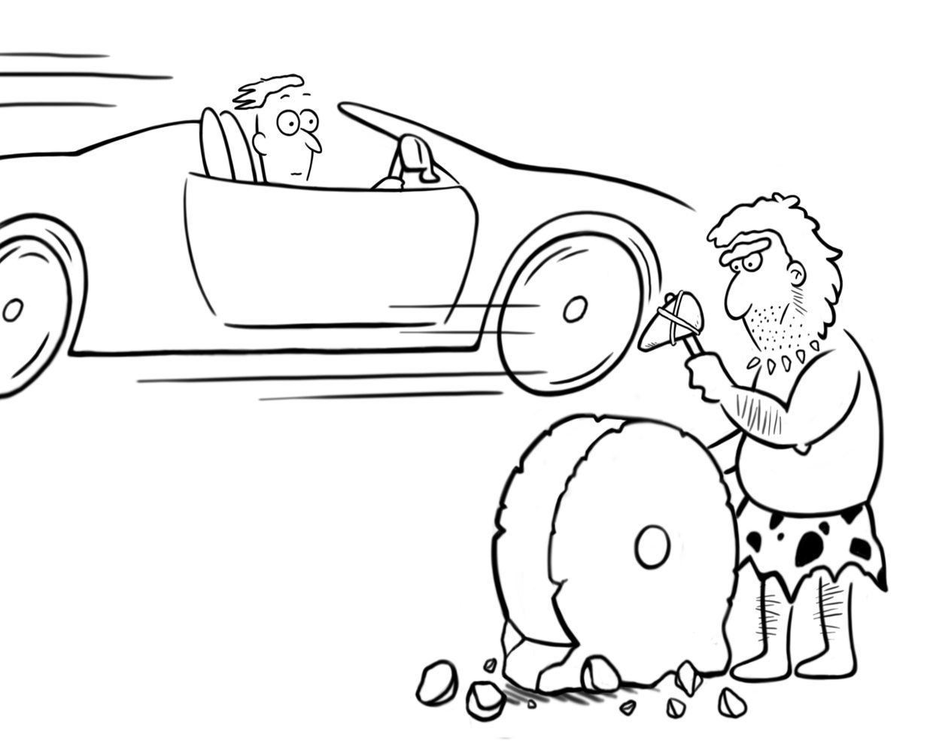



With thanks to:
Phew! I’m glad I went to www.iris-database.org
Key collaborators
Alison Mackey & Luke Plonsky (IRIS)
Sophie Thompson, Beth Bailey, David O’Reilly, Julie Allinson, Frank Feng (IRIS)
Kara Morgan-Short, Jeanne Heil, David Abugaber (Replication)
Funders

Slide 43
Abstract for the workshop
This session will provide teachers with practical insights into the research process: from the formulation of useful and answerable research questions that are informed by relevant learning theories, through to the design of data collection instruments and the practicalities ofcollecting and analysing data, ending in the interpretation and dissemination of findings. The talk aims to provide some inspiration about potential investigations into issues of relevance to EFL teachers in Higher Education, such as research into collaborative classroom activities, autonomous learning, the flipped classroom, and speaking practice.
In particular the talk will focus on the extent to which different research designs help to determine the effectiveness of teaching. For example, guidance will be given about experimental research designs and how to calculate an effect size, an important yet simple measure of thesize of change. Examples of research tools will be drawn from IRIS (www.iris-database.org). The aim of the session is to increase attendees’ awareness and understanding of the different kinds of evidence that can be used to inform pedagogical decisions.

