Slide 1



Using the IRIS Database for Producing and Replicating Foreign Language Research
Luke Plonskyª, Alison Mackeyª, Emma Marsden^{b}, & Sophie Thompson^{b}
ªGeorgetown University, ^{b}University of York
ACTFL 2017
iris-database.org
Notes:
Not included (yet)
OASIS

Slide 2
The “methodological turn” in applied linguistics (Byrnes, 2013, p. 825)
Numerous new volumes on methods
Methodological syntheses (via meta-analysis)
e.g., Larson-Hall & Plonsky, 2015; Plonsky & Kim (2016)
Statistical literacy, training, and development
e.g., Loewen et al., 2014; Gonulal, Loewen & Plonsky, 2017
Conferences and workshops focused on methods e.g., AAAL, ACTFL SIG! LL Currents (2012); SLRF 2015, 2016
Discussions on research ethics e.g., De Costa (2015); Plonsky et al., (2016); Sterling (2016)
Special issues on methodological topics e.g., replication in JSLW, CALICO, LL&T (2017)
Journal guidelines e.g., Mahboob et al., (2016); Norris, Plonsky, Ross, & Schoonen (2015)
New techniques e.g., bootstrapping, MEM, meta-analysis, Bayesian
e.g., Cunnings (2012); Larson-Hall & Herrington (2010); Norouzian & Plonsky (under review)
Reconsideration of familiar techniques (e.g., group differences, eta2, data viz, ANOVA)
e.g., Larson-Hall (2017); Norouzian & Plonsky (in press); Plonsky (2015); Plonsky & Oswald (2014, in press)
Major steps towards toward transparency, openness, reproducibility, and synthetic-mindedness

Slide 3
What is ‘good’ research?
Good research (i.e., of methodological quality) is…
carried out according to standards of rigor (e.g., appropriate design, valid instrumentation, sufficient power, justifiable analyses)
+ Current thinking
primarily concerned with the extent of the effect or relationship in question (i.e., effect size; see Cohen, 1988, p. 532; Plonsky & Oswald, 2014)
transparent → reported thoroughly (not selectively) and faithfully; raw materials available for inspection and/or re-analysis
reproducible → findings are stable; able to be replicated
Traditional
perspective;
fine, but incomplete
Focus today
Notes:
- Caveat that a lot of the points here will refer primarily to quant research

Slide 4
1. Transparency
How are we doing?

Slide 5
Methodological syntheses-1
L2 written feedback
Substantive domains
Liu & Brown (2015)
Paquot & Plonsky (2017)
Plonsky & Gass (2011)
Plonsky & Kim (2016)
Ziegler (2016)
LCR
Interactionist
SLA
TBLT
Interaction + CMC
Notes:
One way we’ve can understand the level of transparency in our work…

Slide 6
Methodological syntheses-2
L2 instrument-reporting
MMR
Data reporting
Methodological practices
Derrick (2016)
Hashemi & Babaii (2013)
Larson-Hall & Plonsky (2015)
Mizumoto et al. (2014)
Norouzian & Plonsky (in press)
Plonsky (2013, 2014)
Plonsky & Ghanbar (in review)
Plonsky & Gonulal (2015)
Plonsky et al. (in prep)
Thompson et al. (in review)
ARELE Methods
Designs, analyses, reporting
eta²
Multiple regression
FA
GJTs
SPR

Slide 7
Studies excluded due to missing data (usually SDs)
(as % of meta-analyzed sample)
MISSING DATA
MEDIAN
Median K = 16
(Plonsky & Oswald, 2016)

Slide 8
Reporting of reliability coefficients
(as % of meta-analyzed sample; Plonsky & Derrick, 2016)
MISSING DATA

Slide 9
Looking across these syntheses…
Data often missing, unreported, or selectively reported
Omission of info related to methods and data collection (e.g., treatment tasks, length of treatment)
Lack of access to data collection instruments

Slide 10
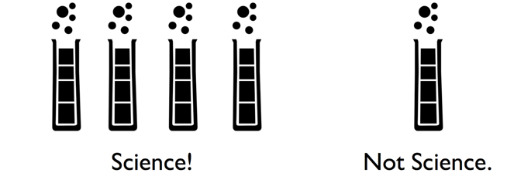
2. Reproducibility
(or replicability)
How are we doing?

Slide 11
Replication in L2 research
Marsden, Morgan-Short, Thompson, & Abugaber (forthcoming)
After much discussion and many calls…
  E.g., Porte & Richards, 2012; Mackey, 2015; In specific areas, e.g., CALL - Handley, 2014; Handley & Marsden 2014; Writing - Polio & Gass 2007; Porte 2012 & 2015. Special sections in journals e.g., Language Teaching; Studies in Second Language Acquisition
…relatively few self-labelled replications
Systematic review: only 105 studies with “replication” in title or abstract

Slide 12
OK, but why should we engage in replication research?
Science is (or should be) self-correcting* by nature
Our studies are generally based on small samples → unstable results.
To examine the generalizability of our results: e.g., to additional contexts, TLs, target structures, proficiency levels
We need to be able to have sufficient trust in our findings to apply them to practice and to refine theory.
It’s a great way to learn (or teach others) how to do research.
*Replication is NOT just about proving each other wrong.

Slide 13
REPLICATION BONUS 1
Plonsky et al. (in prep)
  Coded 25 journals (K = 2,024) for bibliometric and methodological features
  Survey of L2 researchers’ perceptions of journal prestige (N = 327)
  The three journals with the most replications also had the highest ratings of prestige: LL, SSLA, MLJ
  Journal prestige x journal transparency: r = .72

Slide 14
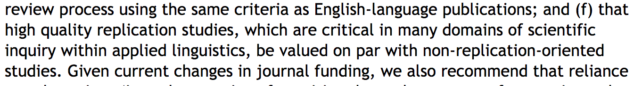
REPLICATION BONUS 2
In a recent (2017) revision of their guidelines on Promotion & Tenure, AAAL recommends…

Slide 15
To what extent does our research replicate?
From 32 self-labelled replication studies in SLA (1973-2013; Marsden et al., forthcoming)
  7 reported clear replicated findings
  13 found context-dependent differences to original
  12 produced contradictory findings

Slide 16
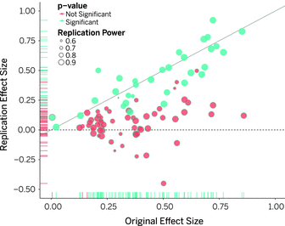
At least we’re not alone?
Large, multi-site replication of 100 prominent psychology studies
Over half the original findings did not replicate (effect sizes within 95% confidence intervals of original studies, Reproducibility Project, OSF Collaboration 2015)

Slide 17
To summarize so far
It’s not looking good for either
transparency
or
2. replicability

Slide 18

Enter…

Slide 19

What is IRIS?
Instruments for Research Into Second Languages
IRIS: Marsden, Mackey, & Plonsky (2016)
A sustainable digital repository
1,100+ materials used to collect data
e.g. questionnaires, grammaticality judgment tests, observation & interview schedules, word lists, sound & video files, language tests, pictures, teaching materials, software scripts,
And ANALYSIS PROTOCOLS and DATA
Downloadable
Uploadable
Searchable
Marsden, E., Mackey A., & Plonsky, L. (2016). The IRIS Repository: Advancing research practice and methodology. In A. Mackey & E. Marsden (Eds.), Advancing methodology and practice: The IRIS Repository (pp. 1-21). Routledge.
‘Academy Research Project’ AN110002

Slide 20

Rationale behind IRIS
IRIS: Marsden, Mackey, & Plonsky (2016)
Materials can be adapted to suit different contexts, learners, languages
Promotes transparency
Easier to evaluate quality and reliability
Quality assurance: only peer-reviewed publications
Stimulates & facilitates replication

Slide 21
Content-1
IRIS: Marsden, Mackey, & Plonsky (2016)
Spanning the entirety of L2 research…
Motivation, identity, & strategies
Language learning
…in diverse contexts
…with diverse types of data
… with diverse research aims
L2 perception & processing
Bilingualism
Phonology
Grammar
Vocabulary
Pragmatics
Language teaching, & policy

Slide 22
IRIS: Marsden, Mackey, & Plonsky (2016)
Content-2
2,320 files → over 1,100 data collection instruments
  New materials contributed almost daily
From 1,229 researchers
Searchable across 330+ parameters,
  research area
  type of instrument
  language feature
  L1, L2
  participant characteristics: age, proficiency
  author
Materials qualify for IRIS if used for a peer-reviewed publications OR a doctoral dissertation

Slide 23
IRIS: Marsden, Mackey, & Plonsky (2016)
Don’t just take our word for it!
Submission to IRIS supported by 37 journals
  In acceptance letters from editors to authors, and in author guidelines (including FLA)
Upload to IRIS in publication guidelines of the AAAL
Only venue in AL that qualifies articles for Center for Open Science badges
20,000+ downloads (as of Nov 2017)
Cited in handbooks, methods books, position pieces & syntheses
Used in many research methods training courses

Slide 24
Four things YOU can do with IRIS

Slide 25
1. Building on / replicating others’ work (avoid re-inventing the wheel)

Slide 26
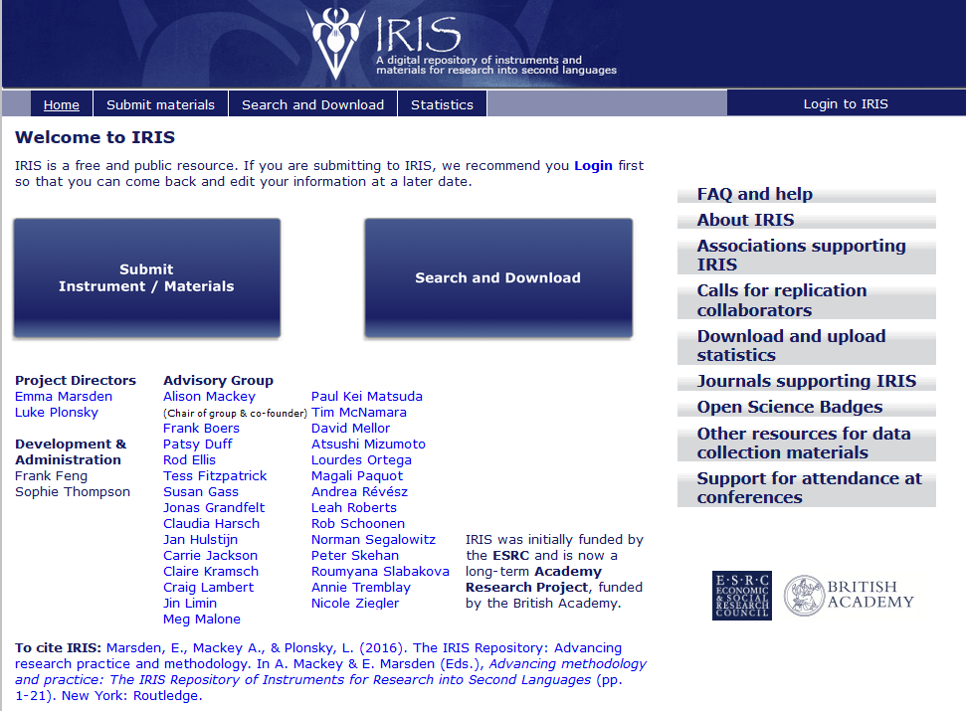

Slide 27
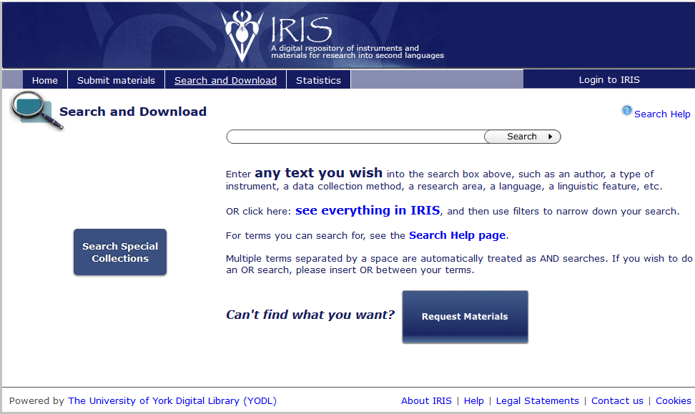
OR

Slide 28
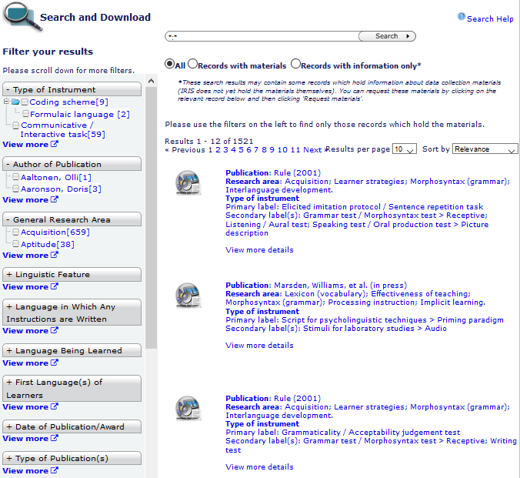

Slide 29
1. Replicating previous research using IRIS
1. Search for instruments and materials from published studies on IRIS
2. Refine search based on criteria relevant to you study (e.g., target skill, target language, age group)
3. Download relevant materials
4. Adapt as needed for your study.
If a given set of materials is not available, fill out a request and we’ll contact the author for you!

Slide 30
2. Researcher training

Slide 31
2. Researcher training
Through replication
Surveying available materials in a given area
Evaluating existing materials/assessments
Improving, expanding, validating, available materials

Slide 32
3. Teacher training and finding materials for L2 instruction and assessment

Slide 33
3. Teacher training / use
As a means to bridge research and practice. “Would the findings of this study really work in my classroom?”
Action research
Build teachers’ confidence in research and in their own ability to conduct research
e.g., “direct object” → Spanish

Slide 34
4. Contribute!
TO CONTRIBUTE
TO IRIS

Slide 35
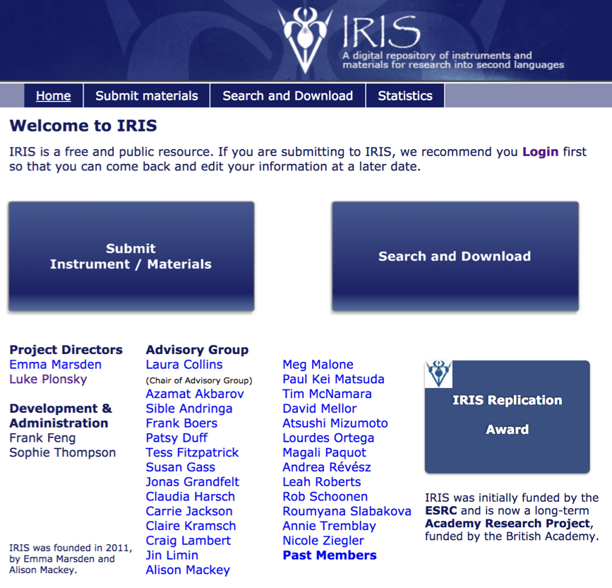
It only takes a few minutes
We welcome any and all materials
from published or doctoral work
Get notified when others’ download
your materials (if you want)

Slide 36
Some examples of studies and materials on IRIS

Slide 37
Why are my learners studying English?
What motivates them?
You, C., & Dörnyei, Z. (2016). Language learning motivation in China: Results of a large-scale stratified survey. Applied Linguistics.

Slide 38

Title / type of instrument(s): motivation questionnaire
Aim of the study: to determine what motivates L2 learners of English (in China)
Sample size: 10,413
Age: 16 -19 (average age range)
Proficiency: various levels: upper-intermediate +
Design: questionnaires sent to learners and completed individually
Findings:
leaners were motivated by both the positive image learning English appears to have
and by the drive to do well outside school, e.g. in work or university.
results were in-line with findings from other countries and cultures

Slide 39
How could you use materials from this study?
use as a needs analysis for your learners at the start of term - this could be repeated at different points to see if motivation changes
use as the basis for assessing motivation and then apply to setting goals for the learners to use throughout the year
Issues
the original was a huge study carried out across China –… would your context see different results
the study only looked at teens and young adults - what about older learners?
implications for teachers are not discussed much in the original – how might the results change teacher behaviour?

Slide 40
Why are my students sometimes unwilling to communicate in class?
Cao, Y. & Philp, J. (2006). Interactional context and willingness to communicate: A comparison of behaviour in whole class, group and dyadic interaction. System, 34(4), 480-493

Slide 41
Title / type of instrument(s): Interview/self-report questions and observation schedule
Aim of the study: to investigate students’ feelings about their willingness to communicate and determine which classroom activities promote student interaction.
Sample size: 10
Ages: 20-50
Proficiency: intermediate
Design: Willingness to communicate questionnaire on day one of the course;
2 observations per week over 4 weeks; interview in the final week.
Findings:
learners behaved differently in different kinds of groupings/contexts
learners’ preferences varied between individuals
teachers should make use of varied interaction activity types in classes

Slide 42
How could you adapt this study?
use the questionnaires to allow learners to assess their WTC and adapt classroom interaction activities accordingly
use the observation schedule to deliver CPD to raise awareness of different interaction types
run a replication study using a bigger sample and/or different kinds of learners
use as a needs analysis for new students to determine their communication preferences
Issues
the WTC questionnaire may need adapting to match your learners’ experience
  e.g. translating to learners’ L1 if lower proficiency levels
8 observations is quite time-consuming, even to observe just a few learners
  could the observation scheme be adapted to a self-report sheet for the learners to complete?

Slide 43
Interested in investigating vocabulary teaching?
For a study about vocabulary instruction with Chinese university students, Moskovsky et al. (2015) TESOL Quarterly
Includes:
A lesson plan
A productive vocabulary test
A receptive vocabulary test
Moskovsky, C., Jiang, G., Libert, A., & Fagan, S. (2015). Bottom-Up or Top-Down: English as a Foreign Language Vocabulary Instruction for Chinese University Students. TESOL Quarterly, 49(2), 256-277. http://dx.doi.org/10.1002/tesq.170.

Slide 44
Conclusions & Recommendations

Slide 45
Take-away messages
It’s time that we as a community fully embrace both transparency and reproducibility as part of our core definition of what it means to conduct ‘good’ research. Among other things, this means
Embracing the movement toward replication-based generation of cumulative knowledge.
Reporting studies in a broader context / line of research.
Considering previous studies inclusively (not selectively).
Taking an empirical (synthetic / meta-analytic) approach to reviewing previous studies.
Replication is not the easy route, but it’s the right one for (a) refining theory, (b) informing practice, and (c) field-wide efficiency

Slide 46
Take-away messages
We need to think and act as a community → openness, synthetic-mindedness. No single study...
Transparency:
Report full descriptives, test statistics, effect sizes, and reliability/validity data for all variables, measures and relationships of interest (not just those with outcomes that are statistically significant or that confirm hypotheses).
Making data available to others interested in re-analysis.
Making instruments available (via IRIS) for replication and subsequent analysis/adaptation.

Slide 47
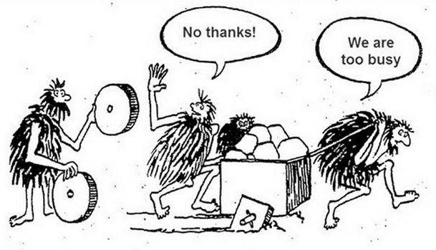
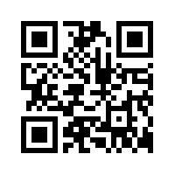
Hey guys, have you seen these on
iris-database.org ?
Thank you!
Questions? Comments?

